Slide 1

Mini Command cart
Group 42 :
黃志偉 109000162
許媄香 109000168

Slide 2
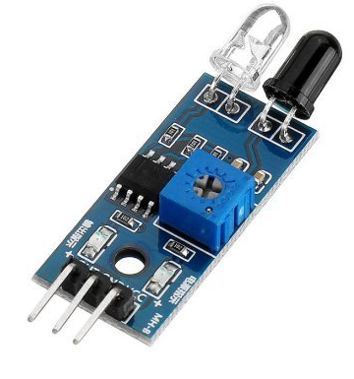


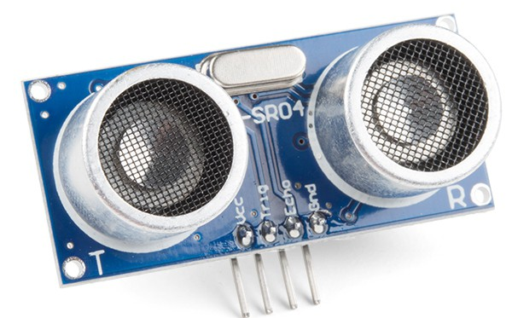
Design concept
Hand Movement Tracing
The Cart will follow the hand or object movement using sensors signal and move accordingly
IR sensor is used to increase sensitivity the tracing & to handle turning which ultrasonic sensor had difficulties in

Slide 3

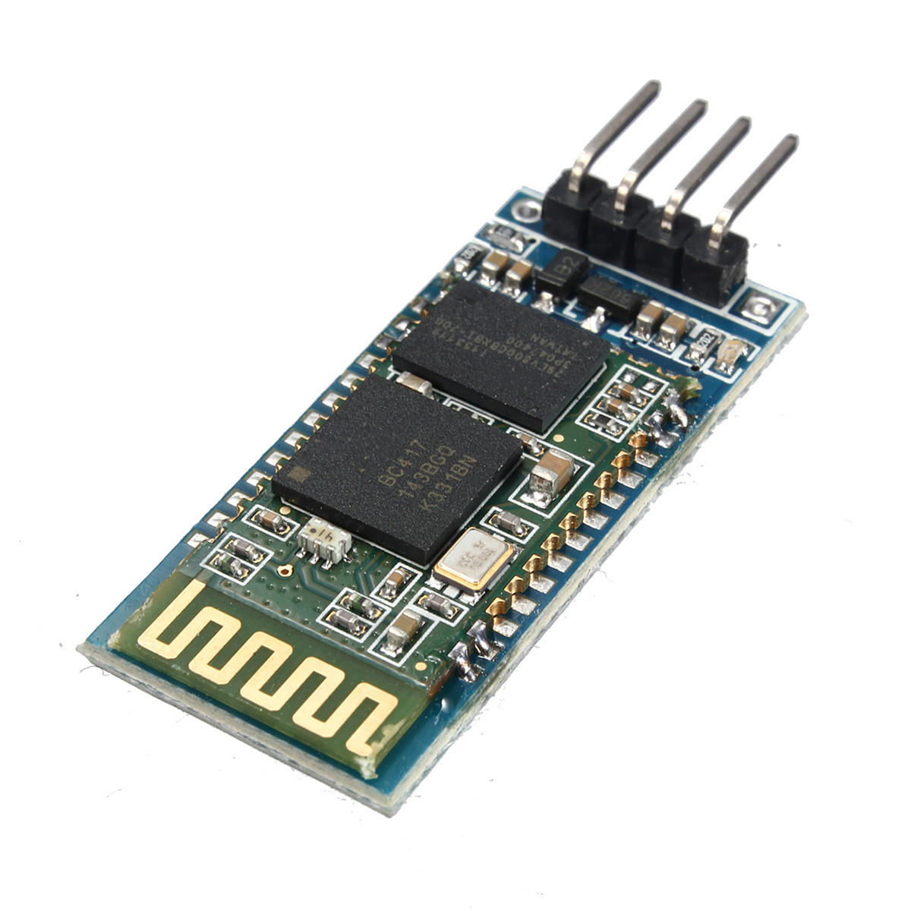


Design Concept
Voice control
Command list :
Go : move forward
Turn left : turn left
Right : turn right
Move backward : reverse
Stop : stop
U-turn : u-turn
Hi : clock-wise rotate
Goodbye : counter clock-wise rotate

Slide 4
Hand Movement Tracing
Distance is between 15cm – 50cm
IR Sensor support to detect left and right
Stop when the distance is smaller than 15cm
It’s better to use wide object (because of ultrasonic)

Slide 5
Bluetooth (HC-06) Slave 8-bit
Board clock frequency = 100MHz
Baud rate = 9600 bit/s
Bit_clock = 100MHz / 9600 (bit/s)
Need to receive 8 bit
Do shifting for 10 times (because add extra condition in read state)
IDLE
READ

Slide 6
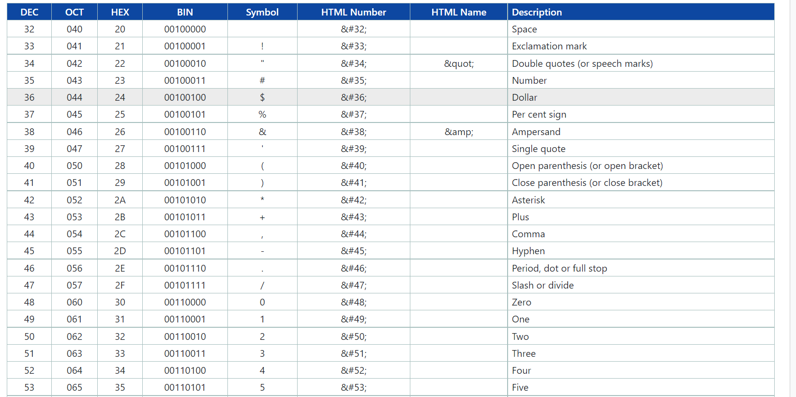

Slide 7
appliances
Hardware :
HC - 06 Bluetooth module ( x1 )
ultrasonic sensor ( x1 )
Flying fish IR sensor ( x3 )
FPGA board
Motor module
Car kits
Battery
Dupont wires
Software :
- Arduino Voice Control App

Slide 8
Work distribution
黃志偉
Top module -
Buy materials -
IR sensor control -
Speaker control -
Timing control -
許媄香
Top module
Sonic module
Motor module
Bluetooth control
Buy materials

Slide 9
Difficulties
Finding the correct timing for the car in turning
Understand how the Bluetooth works
IR sensor too sensitive
Obstacle control

Slide 10
Demonstration
2 MODES :
Mode 1 (Object following) Follow object in front of it
Mode 2 (Speech recognition mode) command :
Go
Turn left
Right
Move backward
Stop
Hi
Goodbye
One
Two

Slide 11
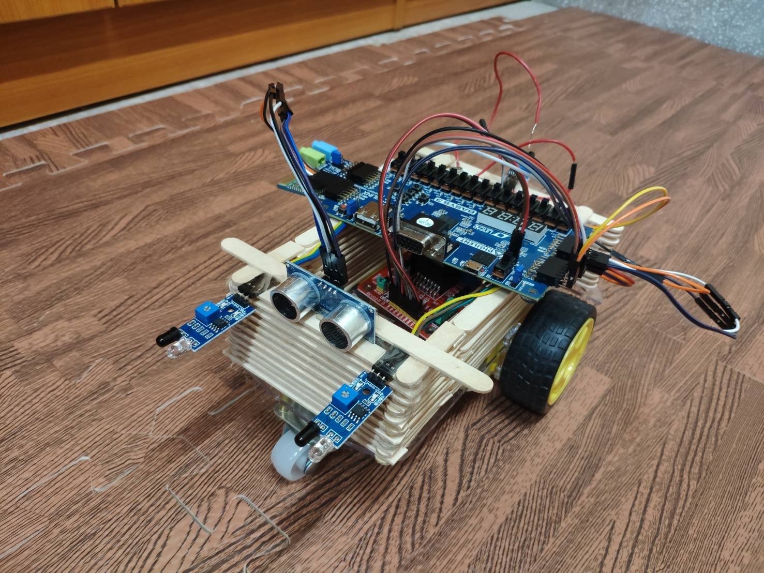
Final

